Slide 1

Analysis of Opioid Deaths in the U.S.
We heart
Dave Gillis
Data Wonders Group
10 April 2023
Javon “that’s our GitHub guy” Seaforth
Amit “everyone’s SME for help with graded challenges” Sharma
Kyle “looks (not brains) of the operation” Eaton

Slide 2
Background/Proposed Analysis
Anecdotal evidence that opioid abuse/opioid deaths are a big problem in the U.S.
News/social media – we constantly hear about all the deaths/issues with opioids
Perhaps we know someone who has passed from opioid abuse
Stressful society we live in today – people are turning to coping mechanisms (e.g., alcohol/drugs, anxiety meds, etc.)
We assume opioid deaths are in the “top 5” category of deaths in the U.S. = “null hypothesis”
Problem/analysis
What are the leading predictors of opioid abuse/opioid deaths in the U.S.?
Goal - want to be able to predict opioid deaths in U.S. to focus resources at prevention = “resources are limited”
Big problem to try and solve/bound – potential datasets initially found are huge
For this first project, we are using large datasets found easily/quickly
Trying to predict opioid abuse/deaths so preventive resources can be allocated to the problem

Slide 3
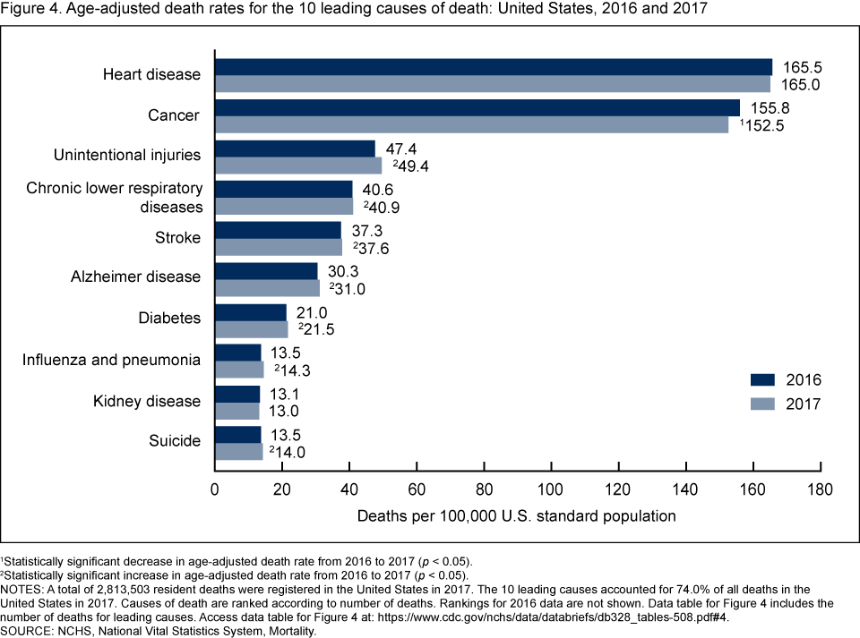
Background/Proposed Analysis (cont.)
Quick look at another analysis shows as recently as 2017, opioid deaths are not one of the leading death categories in the U.S.
Source: CDC.gov
According to another study, 71% of opioid deaths are attributed to ages 25 -54; this is a vital age group for “breadwinning”
Source: National Safety Council
Opioid deaths not in “top 5” (or “top 10” for that matter)... but still important!
Still would like to tackle the opioid problem

Slide 4
Dataset & Methodology
Various data sources (2011 – 2017):
Population - https://www.census.gov
Death by Opioid Type – wonder.cdc.gov
Education - factfinder.census.gov
Income - factfinder.census.gov
Data sources combined into csv. file and found on Kaggle website (www.kaggle.com)
500k+ rows of data
all (50) states represented; 1,890 counties represented
metadata includes county population, education levels, income levels, etc.
Extracted information at national level using “groupby.first” function in Pandas
learned that the data could not be broken down at drug-type level
Revisions to work pushed to GitHub
Descriptive Statistics

Slide 5
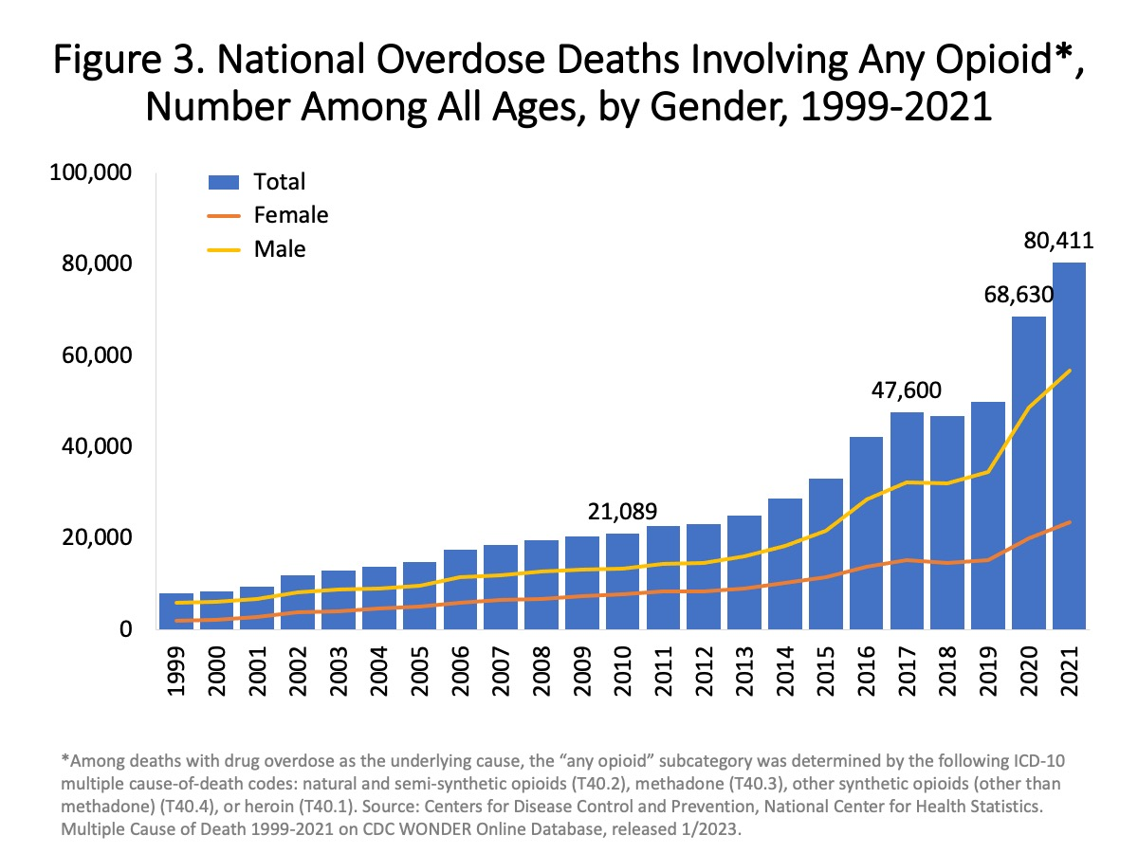
Dataset & Methodology (cont.)
Quick look at another analysis shows 2017 U.S. death count is comparable to the value in our dataset
Source: CDC.gov
Allows us to conclude our dataset can be used confidently for an initial excursion at this opioid problem
47,600 deaths (2017) similar to our dataset value in 2017 (49,608)
Secondary analysis/data source helps validate our dataset may be reliable

Slide 6

First Look at Opioid Deaths at U.S. Level
Opioid death in recent years trending unfavorably – needs further investigation

Slide 7
Possible Predictor of Opioid Deaths - Income
Average annual income for U.S. states regressed against # of opioid deaths in U.S. to see if death prediction plausible
Correlation (rho): 0.93; strong correlation = strong positive relationship
Possible issues w/ regression include:
income increase could be attributed to inflation/price increases
only (6) Degrees of Freedom/(7) datapoints; limited data
Correlation does not equal causation – need to investigate relationship further

Slide 8
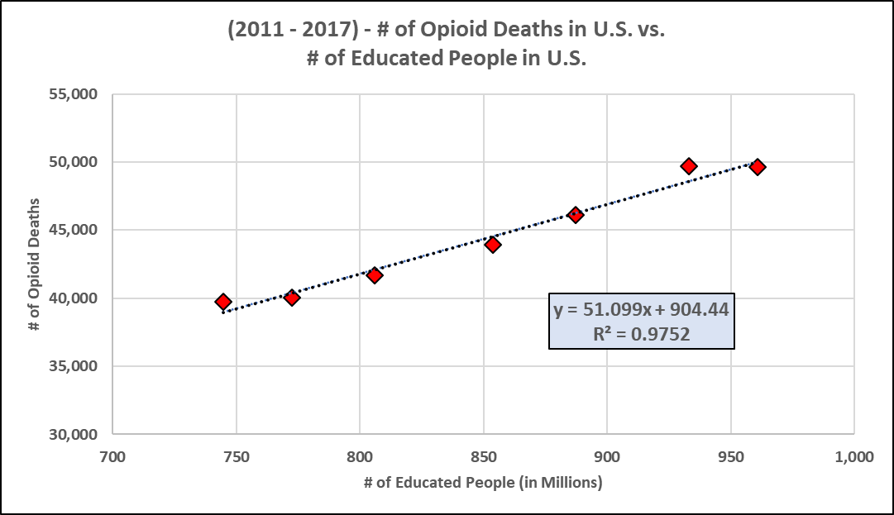
Possible Predictor of Opioid Deaths - Educated
# of educated individuals in U.S. states regressed against # of opioid deaths in U.S. to see if death prediction plausible
Assumption – “educated” equals Bachelor/4-year degrees and Master’s/post-graduate degrees
Correlation (rho): 0.99; strong correlation = strong positive relationship
Possible issues w/ regression include:
uneducated has similar fit = not an important factor in opioid deaths?
only (6) Degrees of Freedom/(7) datapoints; limited data
Correlation does not equal causation – need to investigate relationship further

Slide 9
Possible Predictor of Opioid Deaths - Uneducated
# of uneducated individuals in U.S. states regressed against # of opioid deaths in U.S. to see if death prediction plausible
Assumption – “uneducated” equals some high school, high school grad and some college
Correlation (rho): 0.99; strong correlation = strong positive relationship
Possible issues w/ regression include:
educated has similar fit = not an important factor in opioid deaths?
only (6) Degrees of Freedom/(7) datapoints; limited data
Correlation does not equal causation – need to investigate relationship further

Slide 10
Initial Findings/Considerations
Data Quality
Initial regressions of data (i.e., education, income) not enough to feel confident in understanding opioid abuse/deaths
Potential key subfactors not available in this dataset: age, gender, employment status, alcohol use, criminal history, history of mental health issues, etc.
Opioid Deaths Prevalent in Key Generation
Impacting younger folks – Taking away able-bodied capable people
Hence understanding and solving opioid abuse/deaths vital to our nation (socioeconomic impact, GDP impact, etc.)
COVID-19 Impact
Game changing impact – huge increase in 2020+ opioid deaths (see graph) – need to do further analysis on more recent data

Slide 11
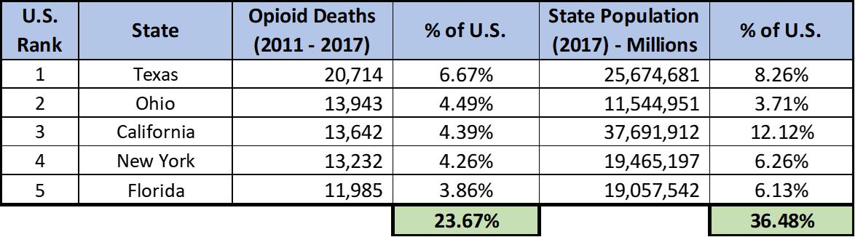
Takeaways/Conclusion
Opioid abuse/opioid death is an issue
Deaths continue to increase & key demographic (young folks) still impacted
How are other countries fairing?
Quality of this data not great
Several factors not available (Age, gender and employment status of people)
Data is older – Need updated information for more accurate conclusion
Analysis potentially needed at state level
Path forward on this analysis still in question
Do we research additional sources of data? Do we investigate at a lower level of data (e.g., gender, state, etc.)? Do we sample the data to make inferences about the population?
Do we pivot towards another analysis?
Quick state analysis shows (5) states comprise large portion of opioid death problem
Opioid abuse/deaths issue requires further investigation

Slide 12
Questions?

Slide 13
Overall Project Summary
Drug addiction and specifically, Opioid abuse, is becoming a significant social issue in the US. A preliminary examination of available data from CDC indicates that there is a steady increase in death via opioid overdose from 2011 to 2017 time frame. Overall goal of the data analysis is to understand drivers of death from opioid abuse and identify areas where funds and efforts should be dedicated to reduce drug abuse and subsequent death rates.
Data available from CDC was analyzed using python for Pandas and Jupyter notebook. Total death count for each year from 2011 to 2017, at US level and state level, was extracted using groupby and loc functionality in python and its variation with income level as well as educational level was investigated. In addition, ranking of death levels by state as well as state’s corresponding population was also examined. All of the extracted data was then exported to excel to prepare linear regression plots.
Data analysis thus far reveals that there is linear relationship between drug use and income levels, as well as education level. Generally, drug use increased with increasing income and increasing education but a deeper dive is needed to understand if the correlation exists by coincidence or if there is a causation here. Analysis at a state/regional level is also needed to understand the trends at a lower level.
Finally, for path-forward, there are other important factors such as subject’s gender, age and employment status which was not available in the dataset used. It would be of value to have access to data which shows impact of subject’s gender, age and employment level. Further, the data is somewhat dated, about 6 years old and does not have information during and after Covid.. There has been a game changing impact on Opioid abuse, post Covid. Therefore, additional data will need to be included in the study to have a complete overview of the crisis.
Another recent data source (yahoo.com and CDC) show that the death rate increased exponentially post Covid, more than doubling versus 2017 timeframe. Therefore, impact of Covid as is needed to determine if the spike was temporary or something has changed fundamentally and permanently.
An expanded exploratory work will help in establishing the key factors responsible for driving drug abuse. Social organizations and governmental authorities can then focus on those factors to optimize efforts for curbing deaths via drug abuse.

Slide 14
Backup

Slide 15
Method
Raw data for 2011 to 2017 timeframe obtained from wonder.cdc.gov as a csv file (over 0.5 M rows)
Extracted information at national level using “groupby.first” function in pandas
Learned that the data could not be broken down at drug type level
completed a regression between opioid casualty and several factors (income, education, employment) at US level
Completed a State ranking by deaths in each state
2022 has been the deadliest year for opioid overdoses in the U.S. (yahoo.com)
Drug Overdose Death Statistics [2023]: Opioids, Fentanyl & More (drugabusestatistics.org)

Slide 16
Takeaways
Drug Use Epidemic?
Impacting younger folks – Taking away able-bodied capable people
Increased econo-social liability of families left behind
Rate of increase in casualty is significant (doubled from 2019 to 2023)
Data Quality
Several factors not available (Age, gender and employment status of people)
Data is older – Need updated information for more accurate conclusion
COVID 19
Game changing impact – Over 81,000 (~ 38% increase yoy) drug overdose deaths in 12 months period. Data need to be added
Government Policies
Open boarders have increased illicit drug activities – need to look at impact

